Slide 2
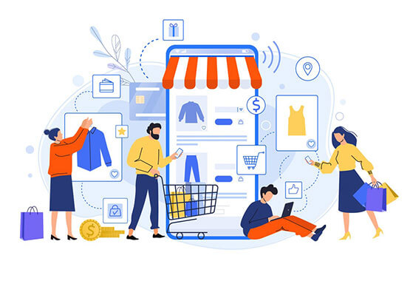
NexUnity

Slide 3

Index
Introduction
Project Profile
Hardware and Software Requirement
Used Technology’s
System Components
Project modulewise Objectives
Context Level Data Flow Diagram
Database Design
Input Layout’s
Context Level Data Flow Diagram

Slide 4
Introduction
Well, our site name is NexUnity. The meaning of NexUnity is upcoming generation and community.
The main purpose behind creating this project is that people of the community can communicate and engage each other easily by using digital interactions .
NexUnity has many features same as other social medias. It provides many features, such as : communication, sharing, and collaboration within these familial networks. Users can engage with one another through messaging, sharing updates, photos, and memories, strengthening bonds across generations and geographical distances.
Additionally, User as well as Admin have authority to create “ Community Account “ .
Moreover ,in this site not contains only other social media features but also used some advanced features , For instance : News , Events , Jobs , and so on.

Slide 5
Project ProfiLe
Project Type | Website
Project Title : | NexUnity
Front End : | ReactJs , JavaScript
Back End : | NodeJS, TypeScript, ExpressJS
Data Base: | MongoDb
Internal Guide :
Submitted To : | Prabhu BCA College
Developed By: | Jenil B Rangpariya Divya I Jadav

Slide 6
Software Requirements :
Operating system Windows10 pro
Web Browser Chrome , Internet Explorer
Database MongoDB
Tools VS code
Hardware Requirements :
Hard Disk 100GB
RAM 4GB
Processor Intel core i5 or Higher

Slide 7

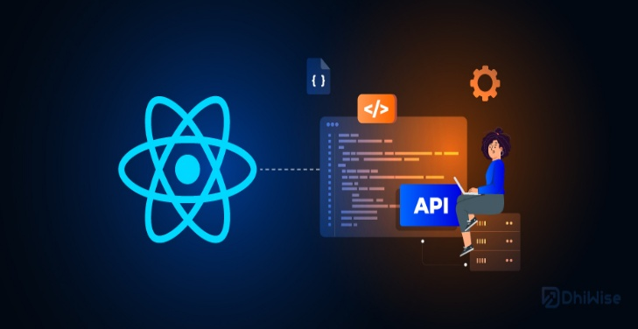



TECHNOLOGY USED

Slide 8
System Components:
Admin
User

Slide 9
SCOPE
The primary objective of the Social Media Website is to enhance user satisfaction by providing a platform for seamless social interaction and content sharing. The system enables users to engage with their desired content and connections within minutes, fostering a convenient and enjoyable social media experience.

Slide 10

PROJECT MODULEWISE OBJECTIVES
Admin :
Login
Registration
Manage user
Forget password
Edit profile
Follow user / Following user request
Category
Post
Events post
Job

Slide 11

PROJECT MODULEWISE OBJECTIVES
User :
Login
Registration
Manage user
Forget password
Edit profile
Follow user
Following user
Create post
Create events post
Create jobs post
Apply jobs

Slide 12
Expected Advantages
Convenient for Users
No Frustration
Cost-Effective
Fast and Efficient Interaction
Reduced Manual Effort
Feedback and Reviews
Support and Communication

Slide 13
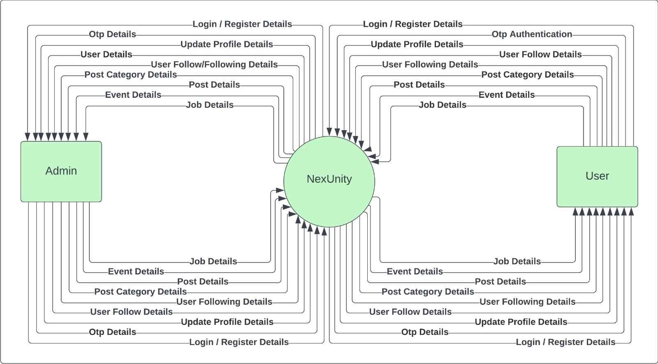
Context Level Data Flow Diagram

Slide 14
DATABASE DESIGN
Field Name | Data Type | Constraint | Description
first_name | String | Require | For storing user details
middle_name | String | Require | For storing user details
surname | String | Require | For storing user details
gender | Number | Default | Gender details
email | String | Require ,Trim ,Unique | Email address
password | String | Require | Password details.
profile_pic | String |  | Profile picture of user
isPrivate | Boolean | Require | Check private or public
role | Number | Default
isRoot | Boolean | Default
active | Boolean | Default
1. User table:

Slide 15
2. User follow:
Field Name | Type | Constraint | Description
fromUserId | ObjectId | Require | Use to store details about followers and followings
toUserId | ObjectId | Require | _id from users collection
isActive | Boolean | Require,Default | request is accepted or not
3. OTP table:
Field Name | Type | Constraint | Description
email | String | Require | for storing otp
otp | Number | Require | Send in email
isVerified | Boolean | Require | Email verified
createdAt | Date | Default | it store otp for 5 minute and then it will auto-delete

Slide 16
4. Post Table:
Field Name | Type | Constraint | Description
createUserId | ObjectId | Require | Use to store post that is posted by user
category_id | ObjectId | Require | Category Details
content | String |  | Details about content
post_type | Number | Require | Type of post details
image | String |  | Images
5. Post Tag Table:
Field Name | Type | Constraint | Description
tag_name | String | Unique ,Require | Use to store details about new hastag that is used by users in their post and help them to see when they search about that particular topic

Slide 17
6. Post Comment Table:
Field Name | Type | Constraint | Description
userId | ObjectId | Require | Use to store post's comment for a particular post.
postId | ObjectId | Require | Store who user comment
content | String | Require | Content Details
7. Post Like Table:
Field Name | Type | Constraint | Description
userId | ObjectId | Require | Use for storing data about number of people like a particular post
postId | ObjectId | Require | who like that post

Slide 18
8. Event Table:
Field Name | Type | Constraint | Description
createUserId | ObjectId | Unique, Require | Used for storing data for event
eventName | String | Require | Name of event
content | string | Unique, Require | Content of event
time | Date | Require | Time for event
location | String | Require | Location of event
eventImage | String | Require | Event Images

Slide 19
9. Job Categories Table:
Field Name | Type | Constraint | Description
category_name | String | Unique ,Require | Use to store post categories
10. Job Table:
Field Name | Type | Constraint | Description
createUserId | ObjectId | Unique ,Require | Use to store details about job post
title | String | Require | Title of job
companyName | String | Unique, Require | Name of company
content | String | Require | Content of particular job
jobImage | String | Require | Image for apply job
applicants | Number | Default | Applicants of user

Slide 20
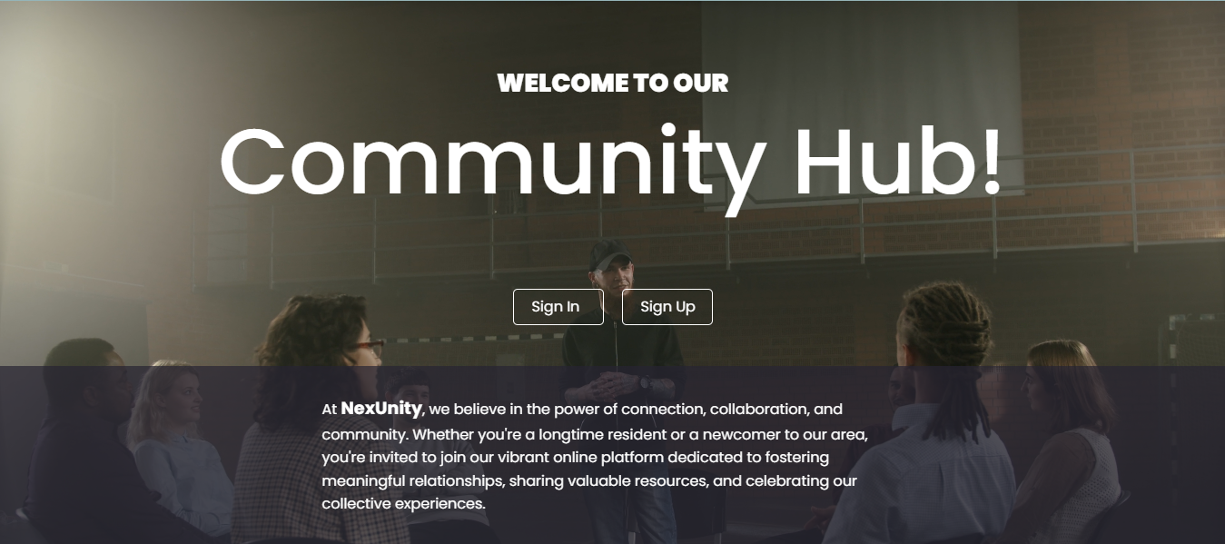
INPUT LAYOUTS
Landing Page:

Slide 21
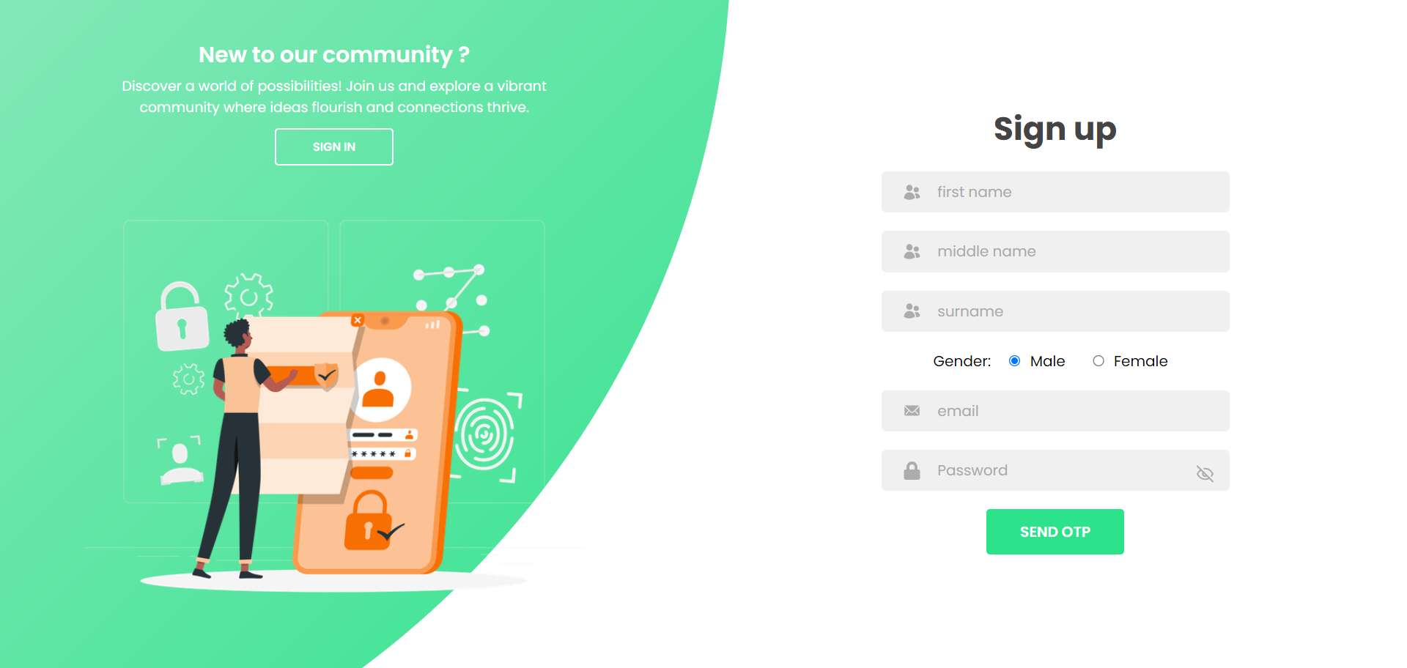
Sign Up Page:

Slide 22
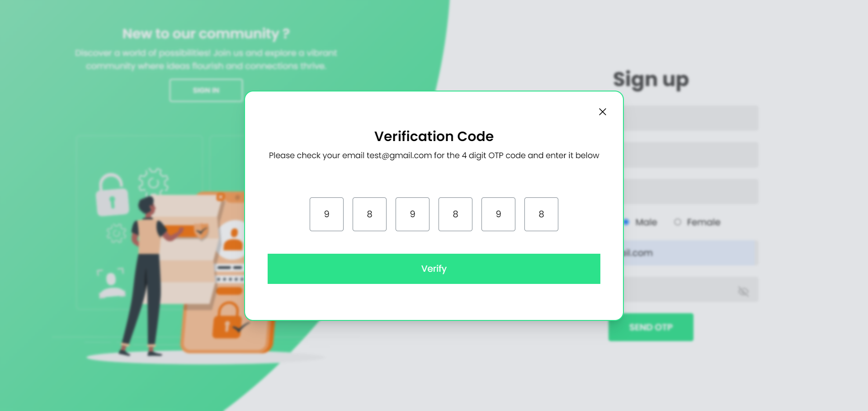
Email Verification:

Slide 23
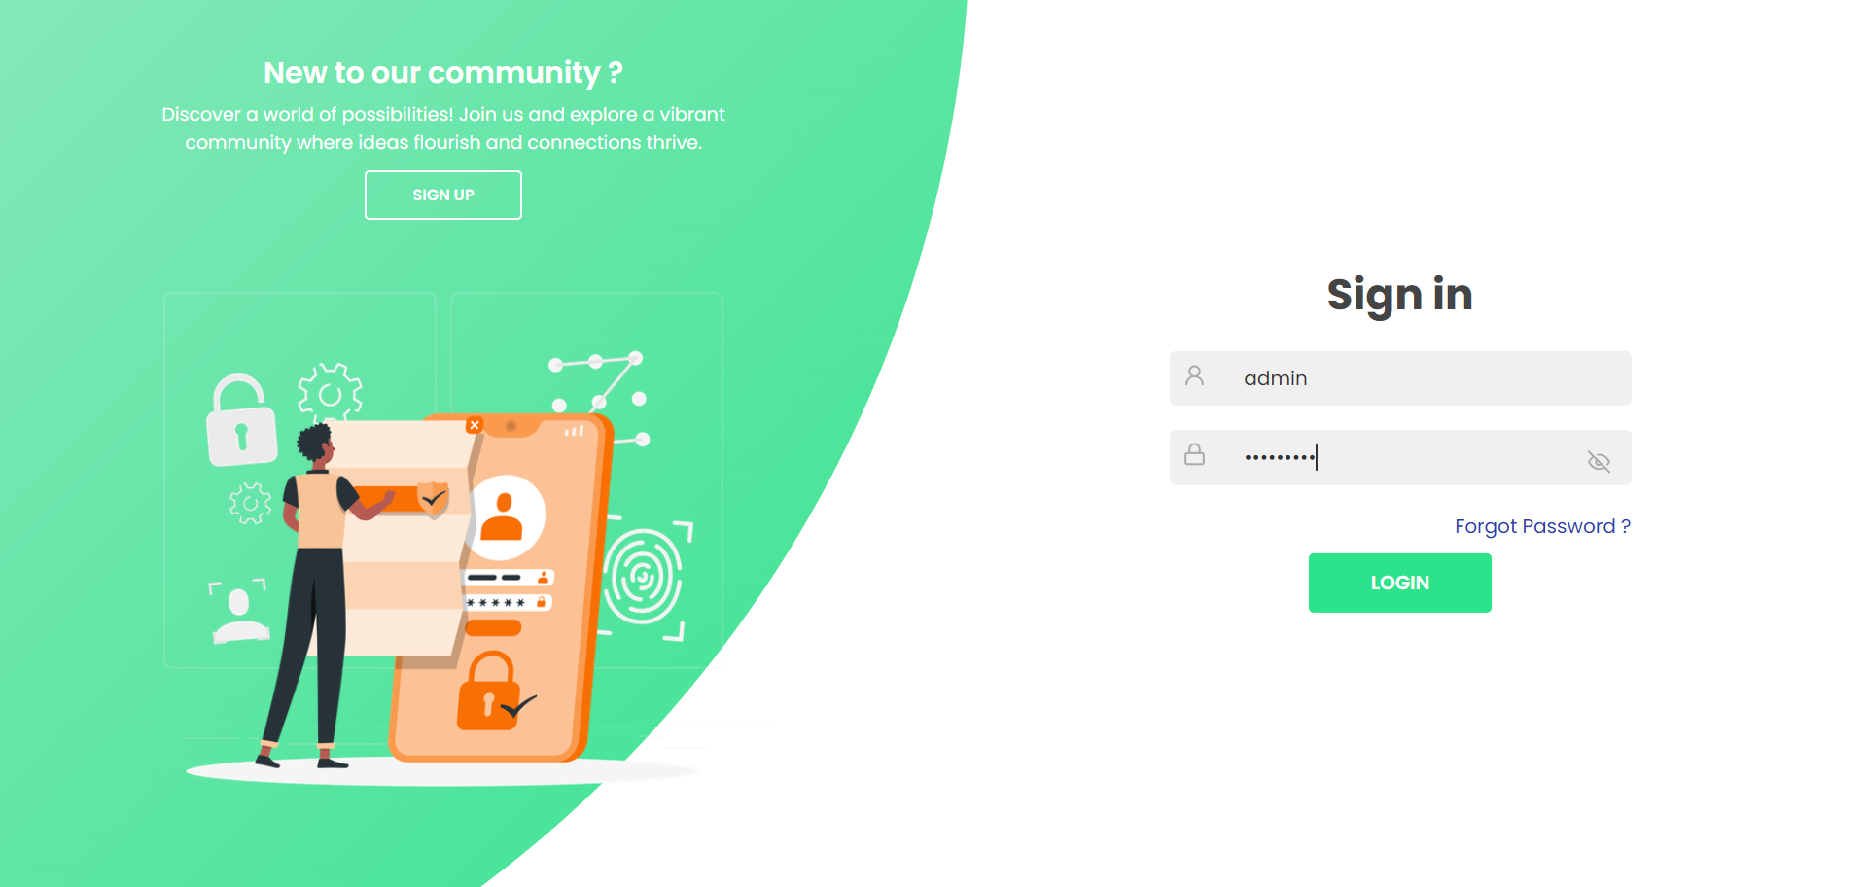
Sign In Page:

Slide 24
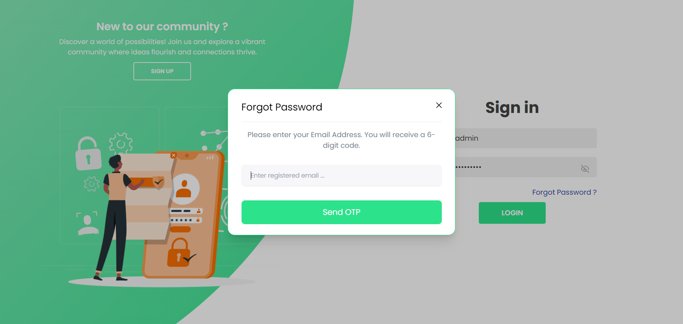
Forget Password:

Slide 25
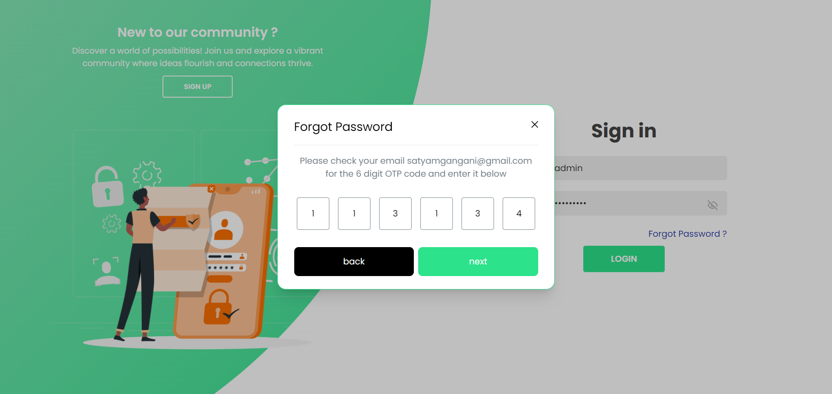
Forget Password Verification Code :

Slide 26
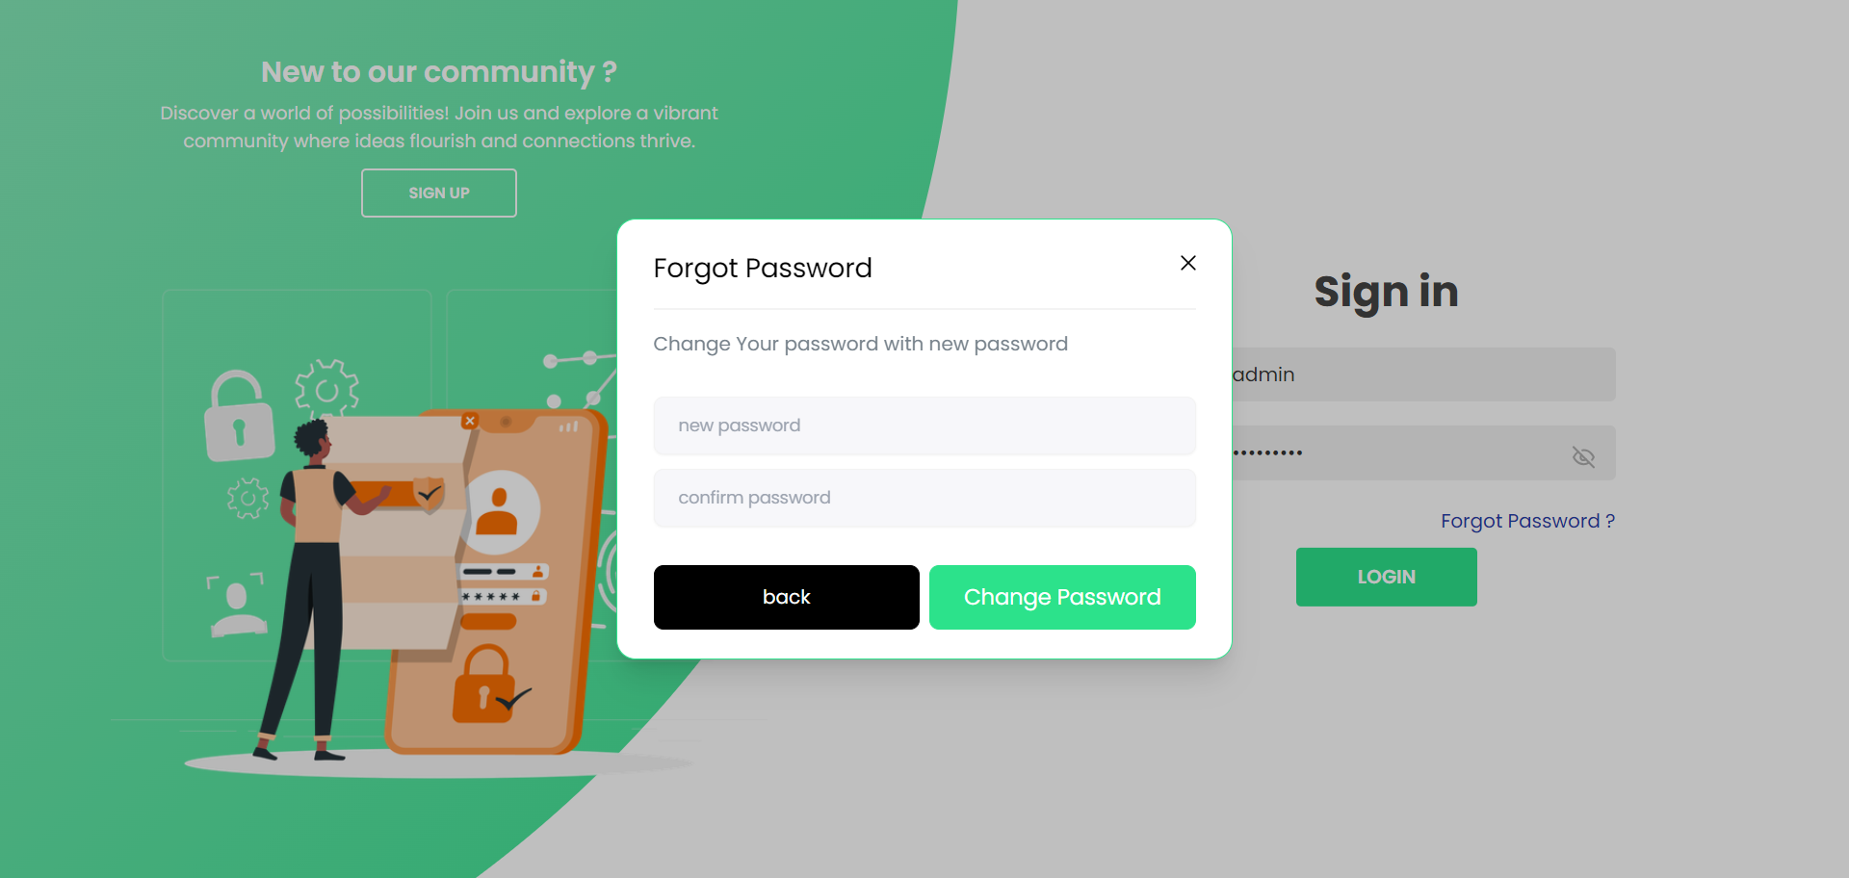
New Password Enter:

Slide 27
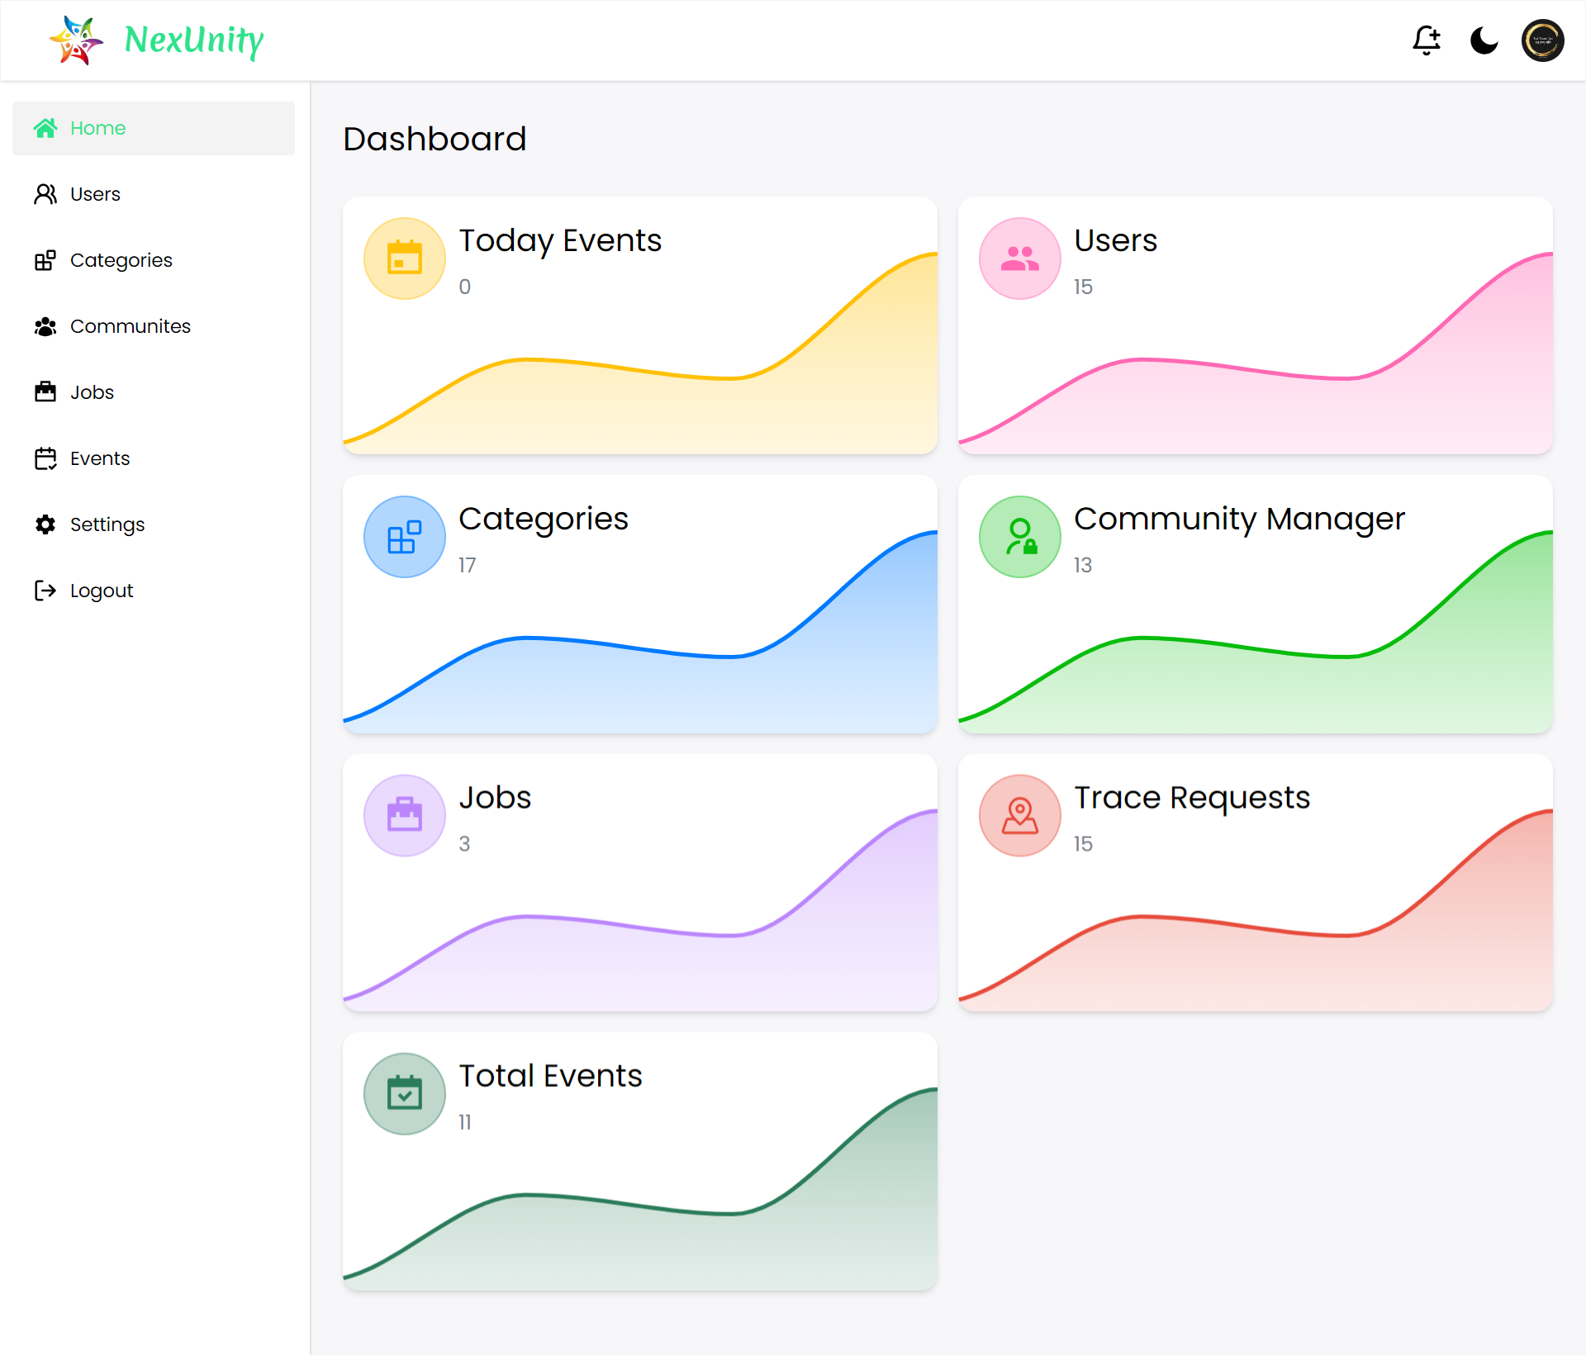
Admin Dashboard:

Slide 28
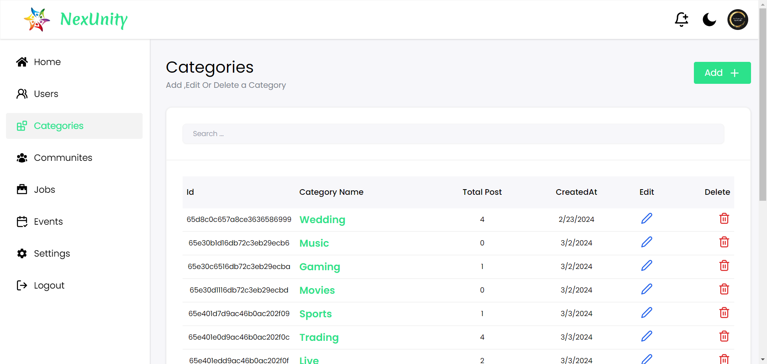
Category Page(Admin):

Slide 29
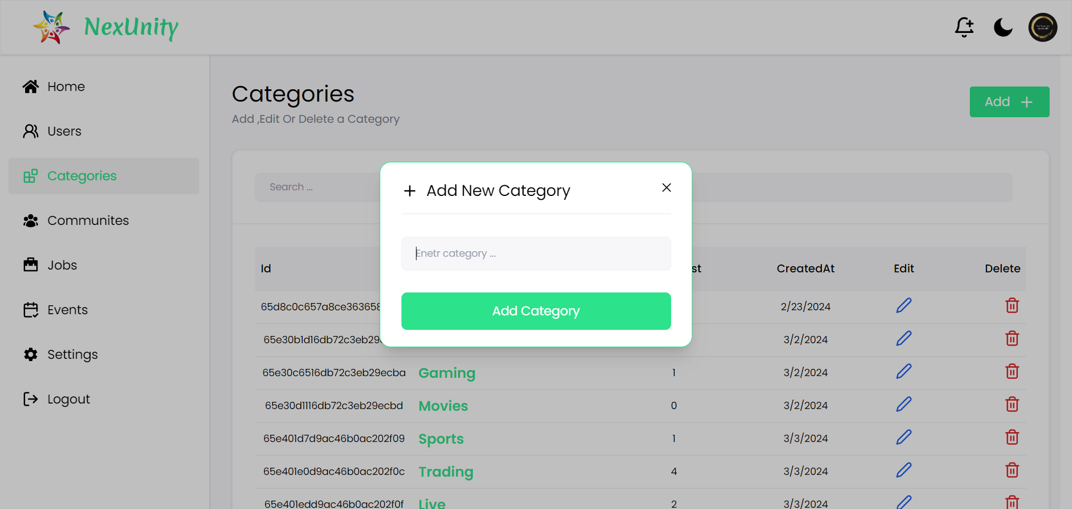
Add Category(Admin):

Slide 30

Update Category(Admin):

Slide 31
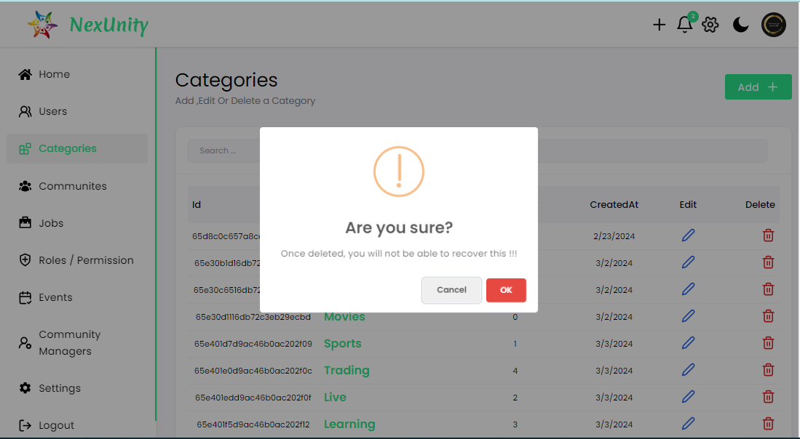
Delete Category(Admin):

Slide 32
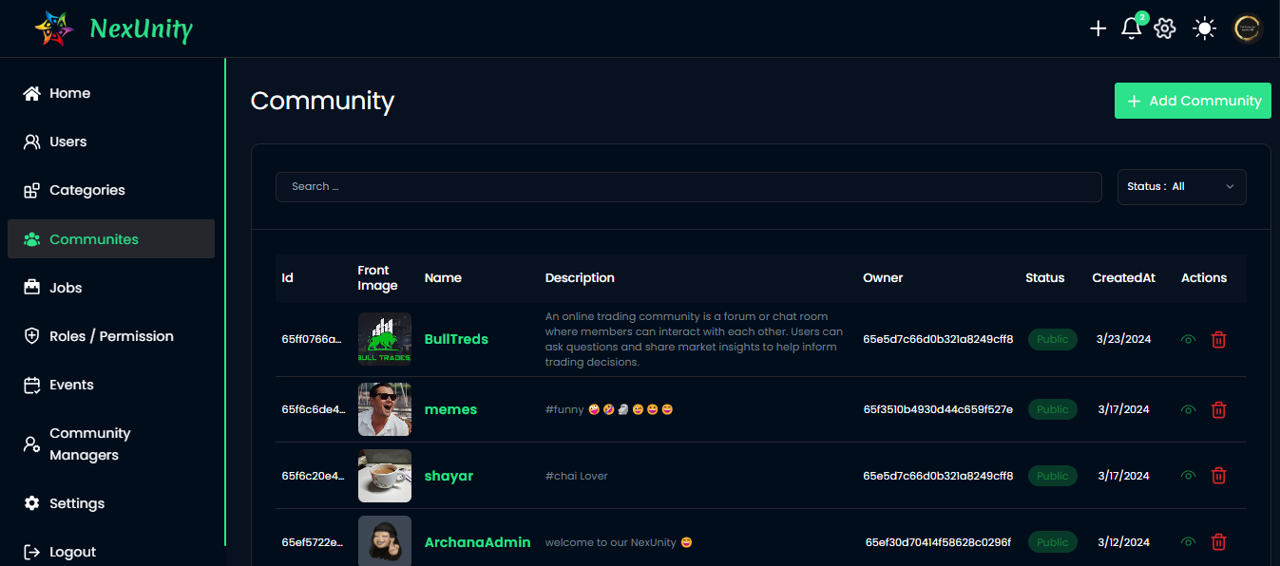
Community Page(Admin):

Slide 33
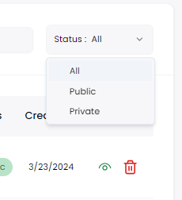
Community Filter(Admin):

Slide 34
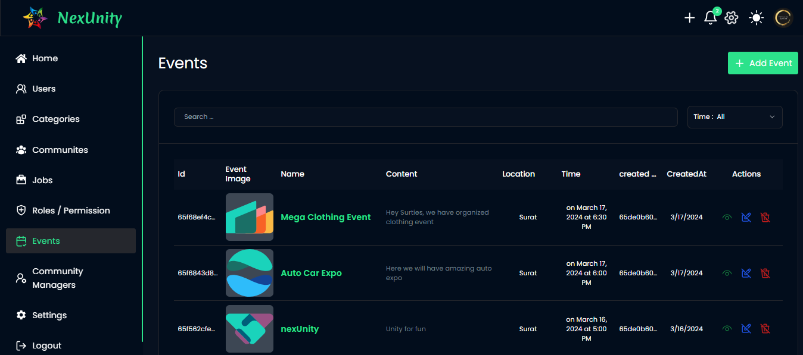
Event Page(Admin):

Slide 35
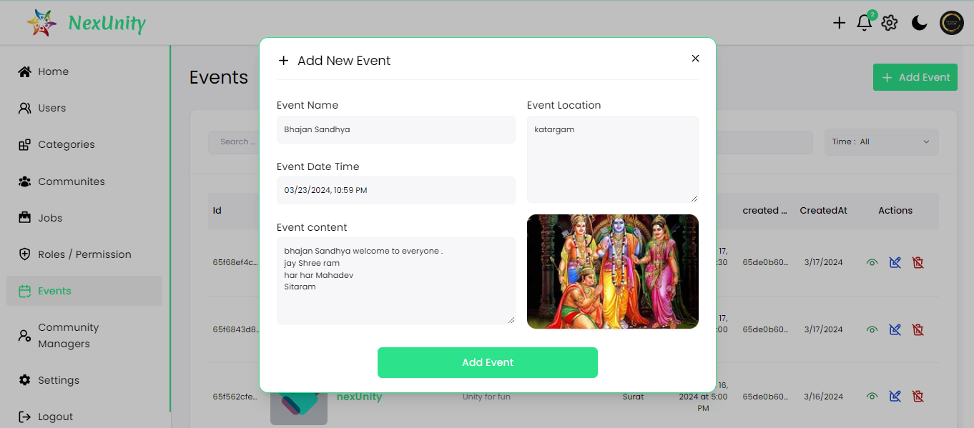
Add Event(Admin):

Slide 36
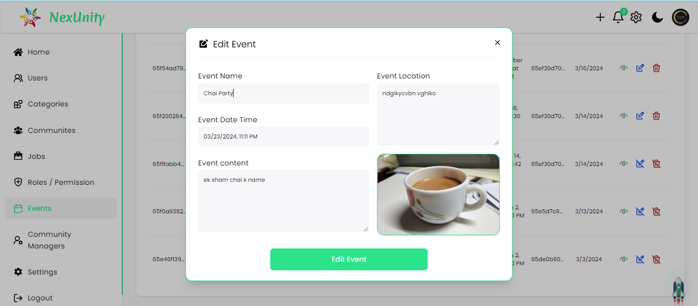
Update Event(Admin):

Slide 37
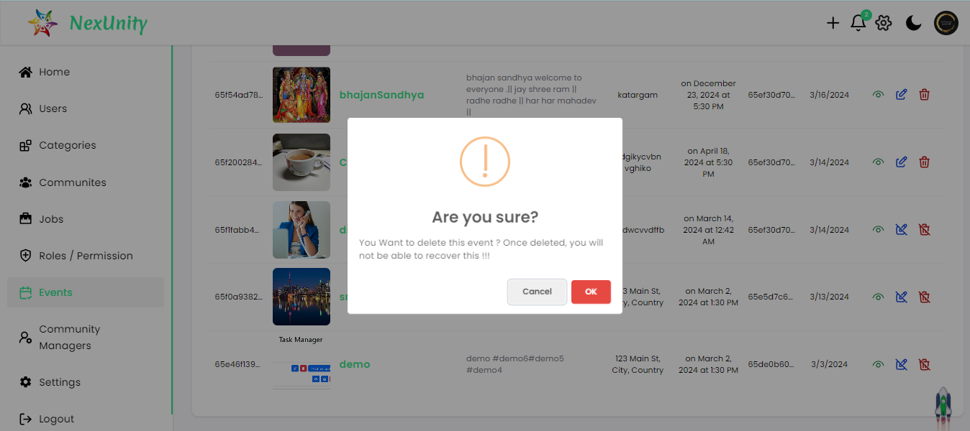
Delete Event(Admin):

Slide 38
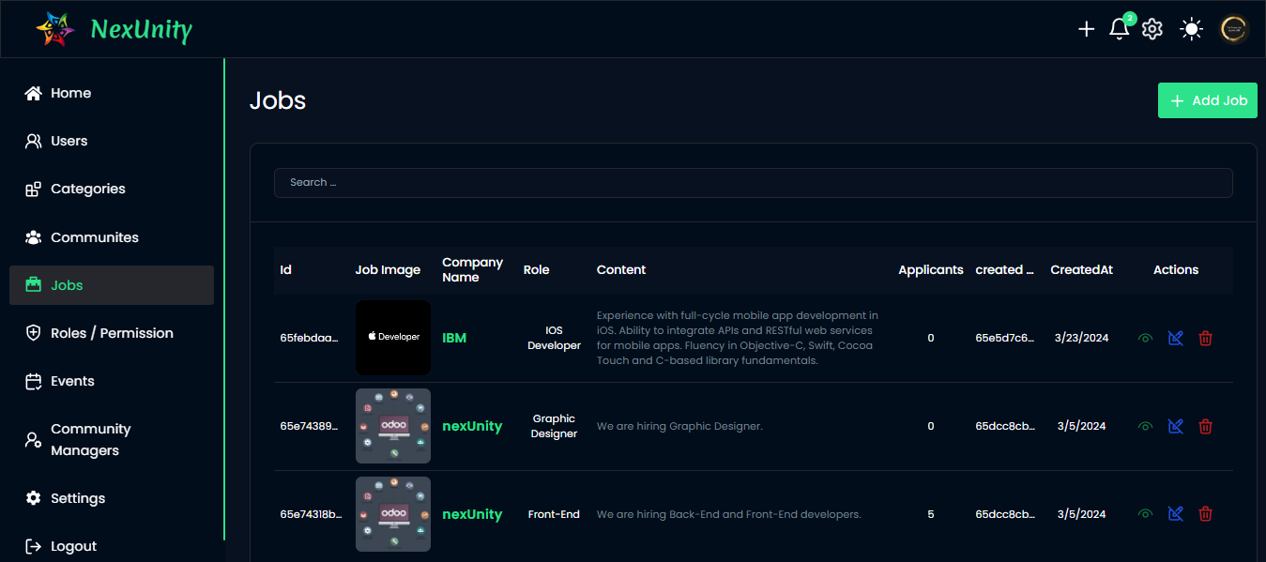
Job Page(Admin):

Slide 39
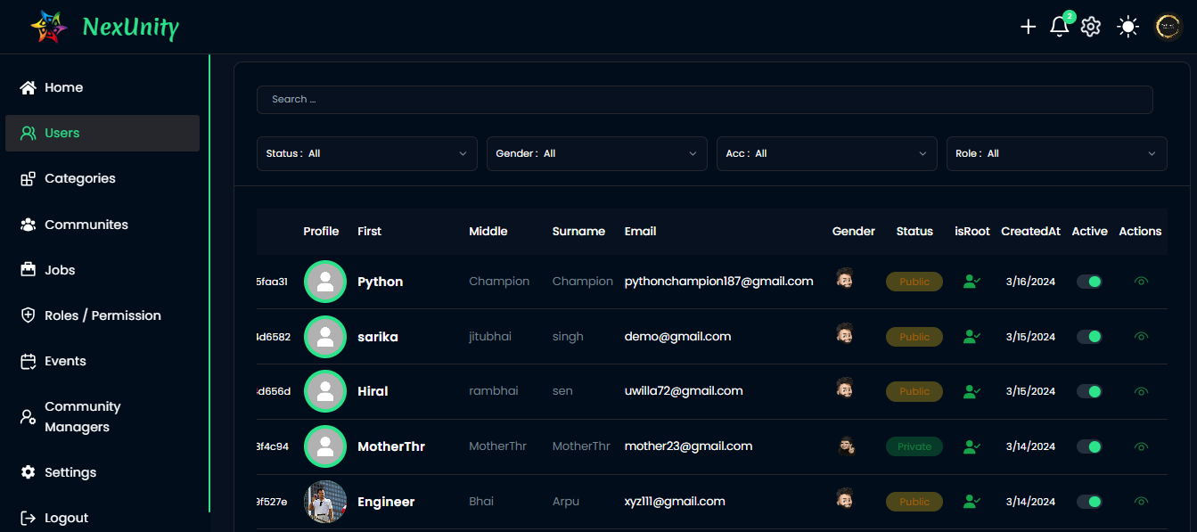
User Page(Admin):

Slide 40
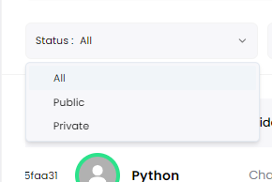
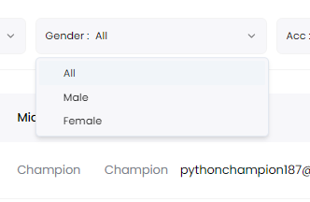
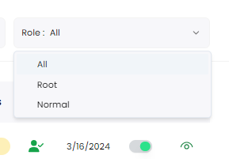
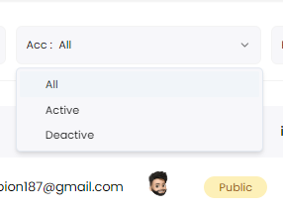
User Page Filter(Admin):

Slide 41
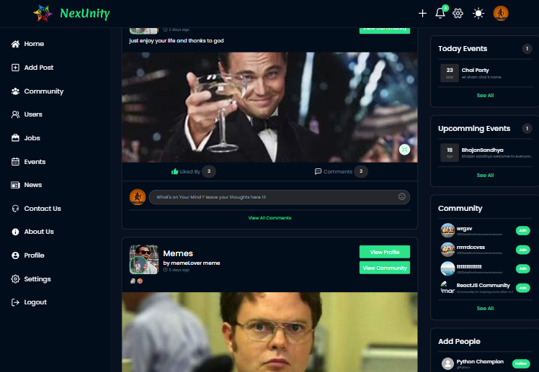
User Dashboard:

Slide 42
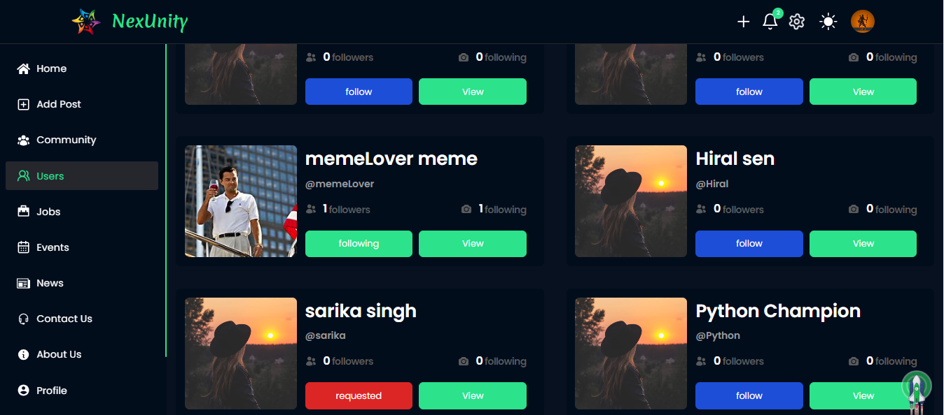
Users View Page(User):

Slide 43
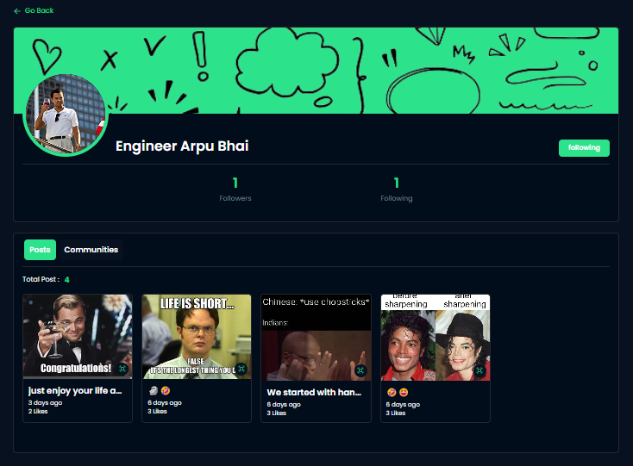
Single User Profile(User):

Slide 44
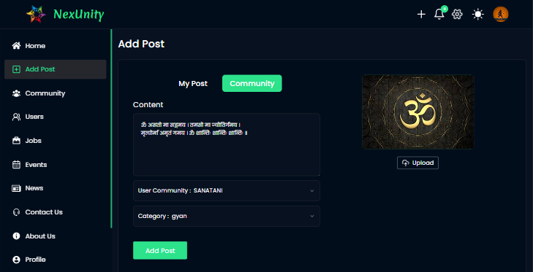
Add Post In Community(User):

Slide 45
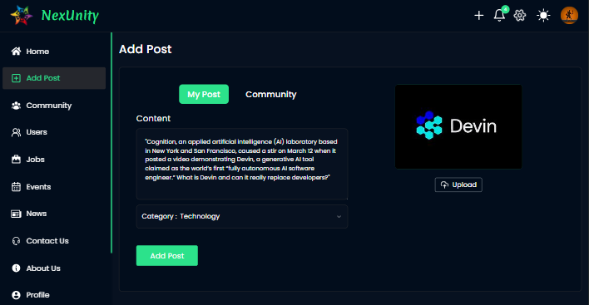
Add Post In Prsonal(User):

Slide 46
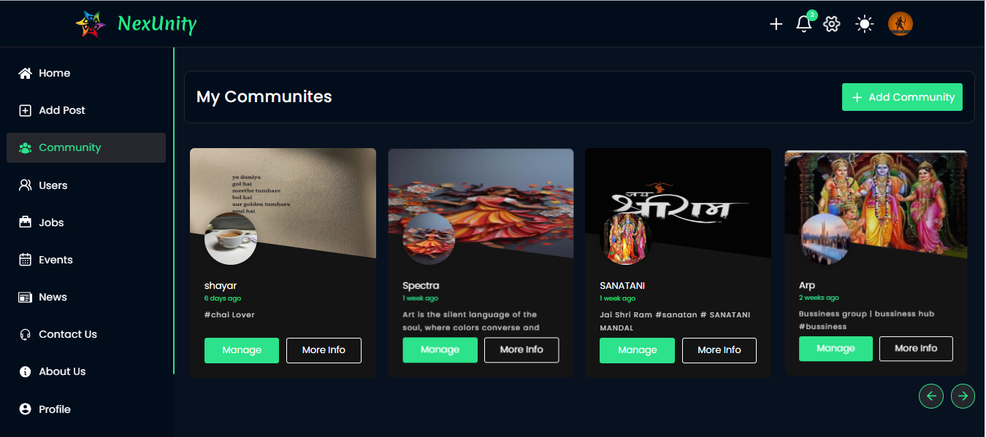
Community Page(User):

Slide 47
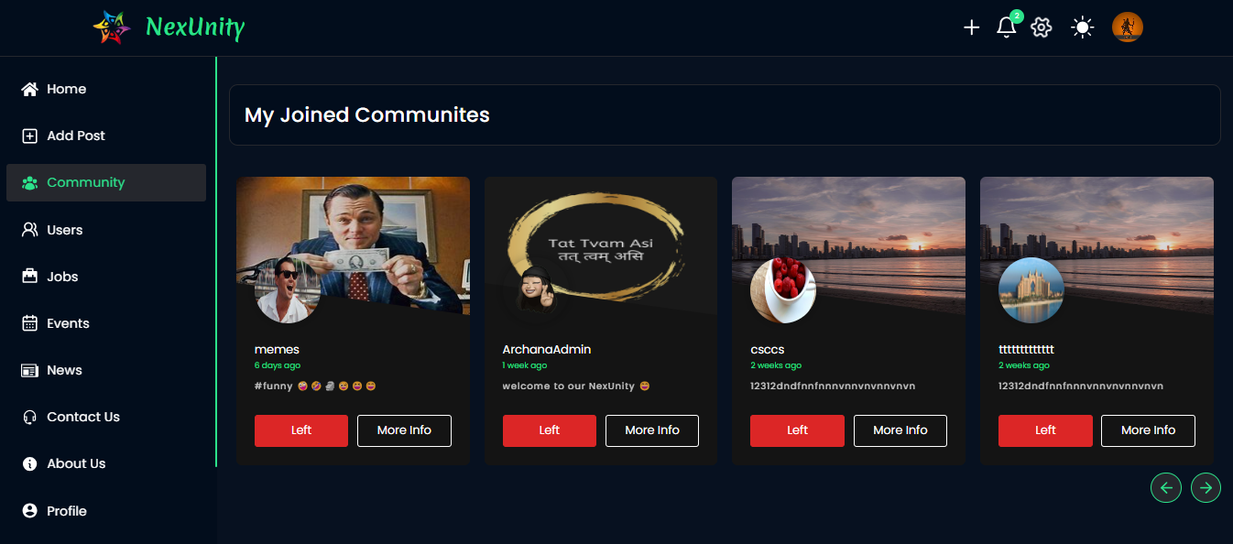
Joint Community(User):

Slide 48
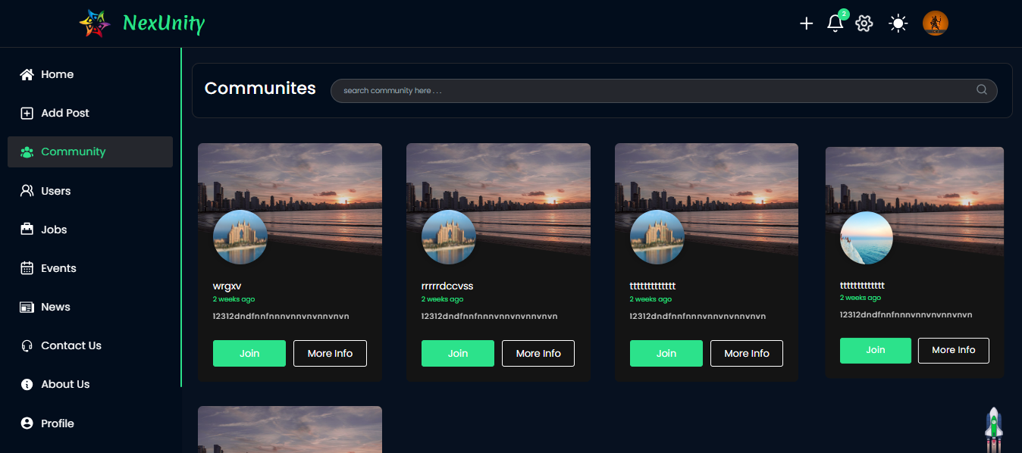
Other Community(User):

Slide 49
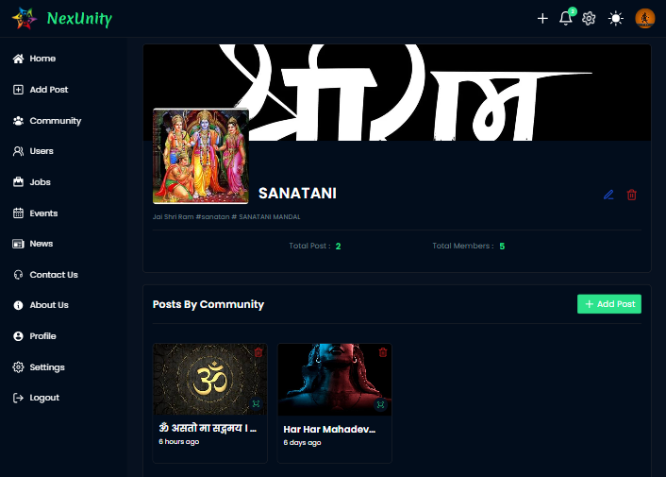
Logged In User( Created Community Details):

Slide 50
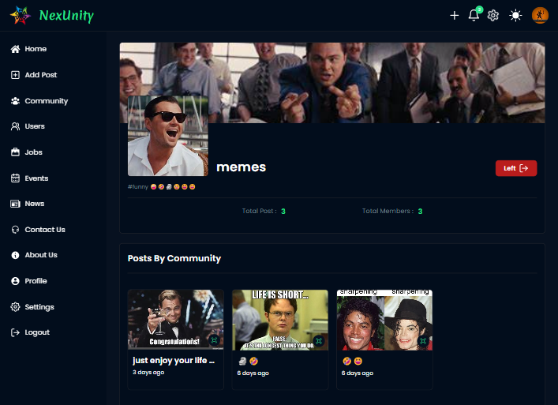
Single Community(User):

Slide 51
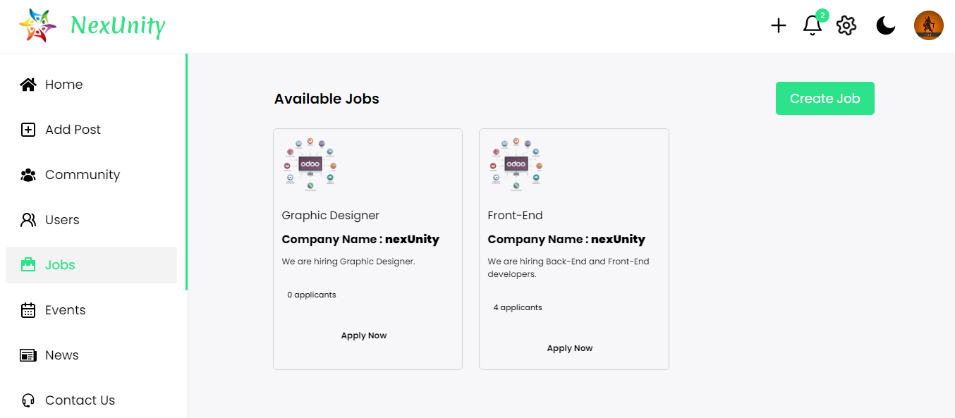
Jobs Page(User):

Slide 52
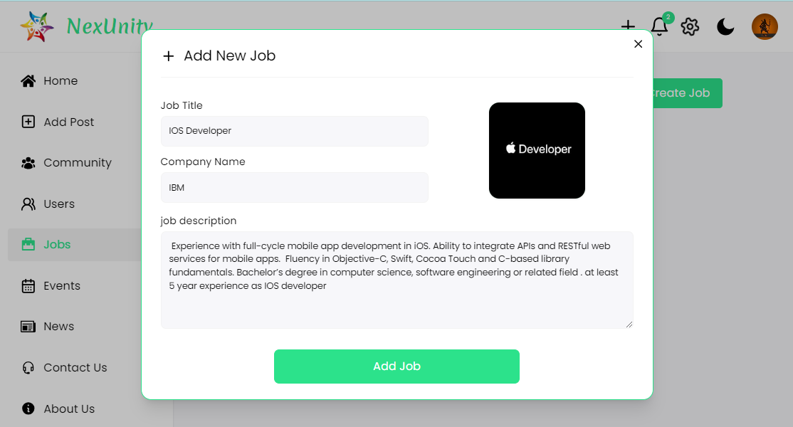
Add Jobs(User):

Slide 53
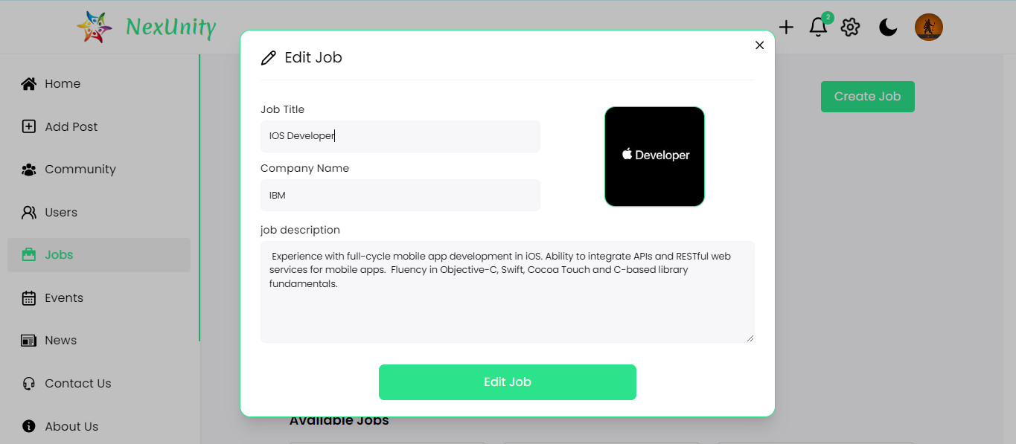
Edit Jobs(User):

Slide 54
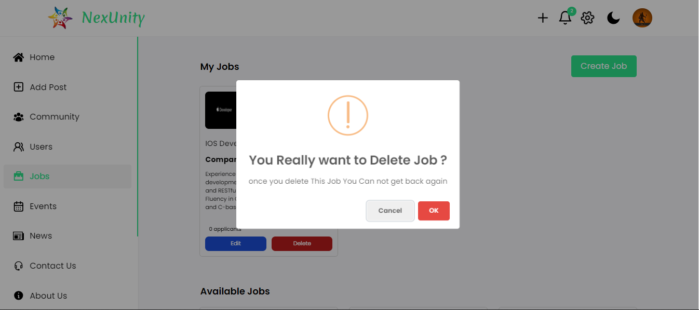
Delete Jobs(User):

Slide 55
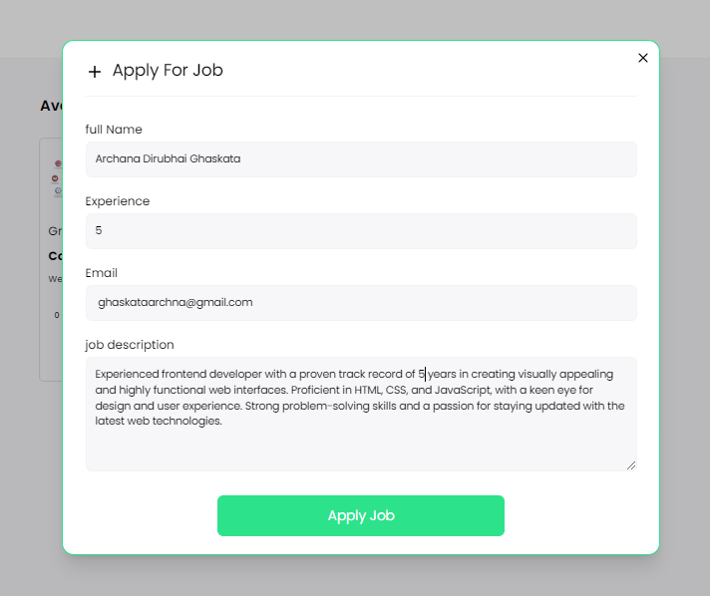
Apply Jobs(User):

Slide 56
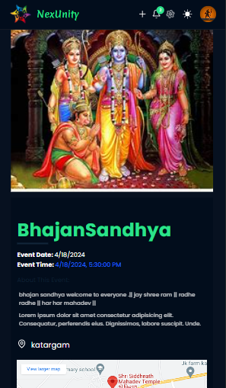
Event Page(User):

Slide 57
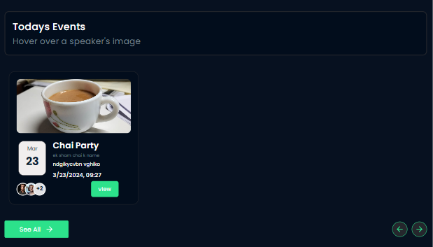
Today’s Events Page(User):

Slide 58
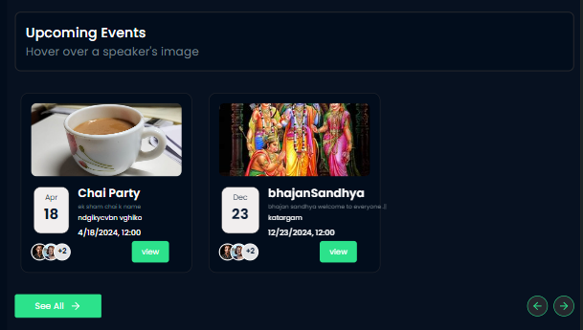
Upcoming Events Page(User):

Slide 59
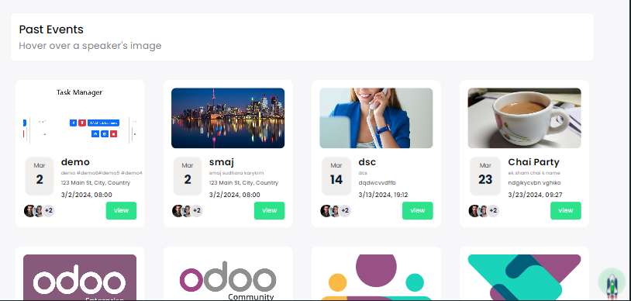
Past Events(User):

Slide 60
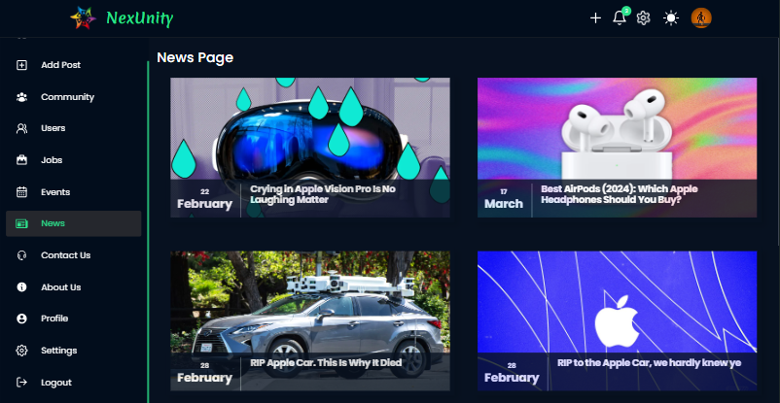
News Page(User):

Slide 61
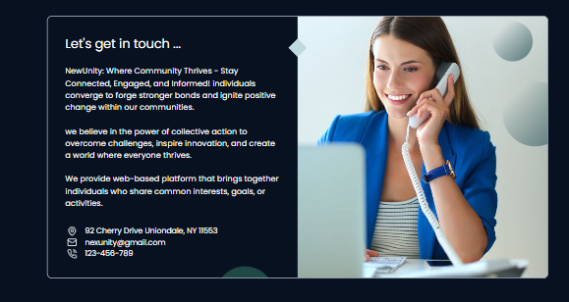
Contact Us Page(User):

Slide 62
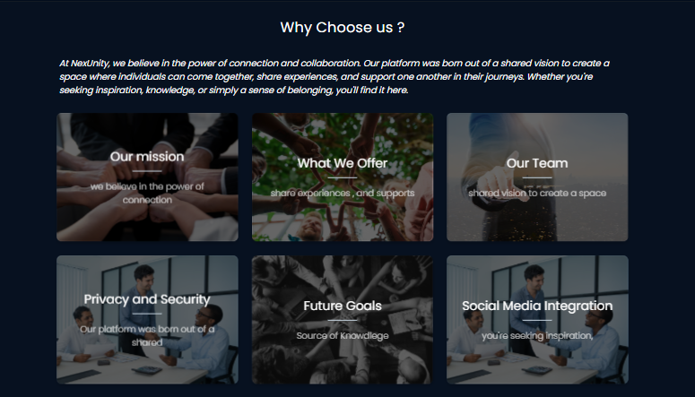
About Us Page(User):

Slide 63
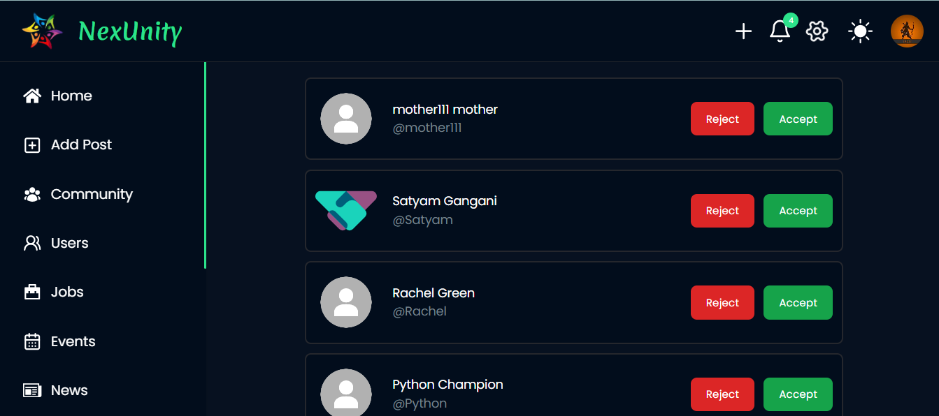
Notification(User):

Slide 64
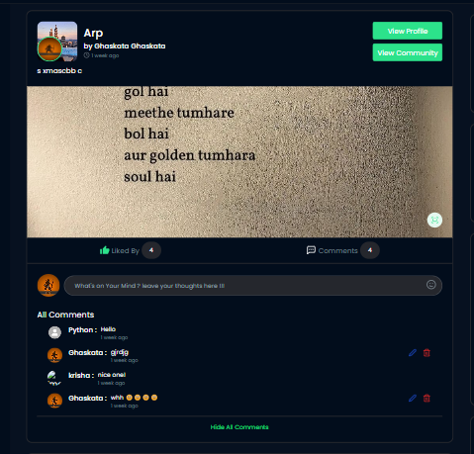
Community Post View(User):

Slide 65

Prsonal Post View(User):

Slide 66

View Image(User):

Slide 67

Like Post(User):

Slide 68
Edit & Delete Comment(User):

Slide 69

Profile Setting(User):

Slide 70

Account Related Advanced Setting(User):

Slide 71

Change Account Password(User):

Slide 72

Logout(User):

Slide 73
LIMITATION AND FUTURE SCOPE ENHANCE
Limitations of System
Net connection requiring to run this system.
It will take a time to send OTP on particular email address because using nodemailer authentication and human verification .
It has also some limitations : Privacy issues , Fake news ,Cyber bullying , addiction , and many more .
Future Enhancement of System
Let people follow each other to make connections and chat.
Allow users to like and comment on posts to show appreciation and start conversations.
Notify users about job openings that match their skills or interests to help them find work.
Give users a way to share their thoughts and get support if they have problems.
Make sure posts and interactions follow the rules to keep the platform friendly.
Keep user information safe and follow rules about privacy to build trust.

Slide 74



Thank You !

